Slide 1

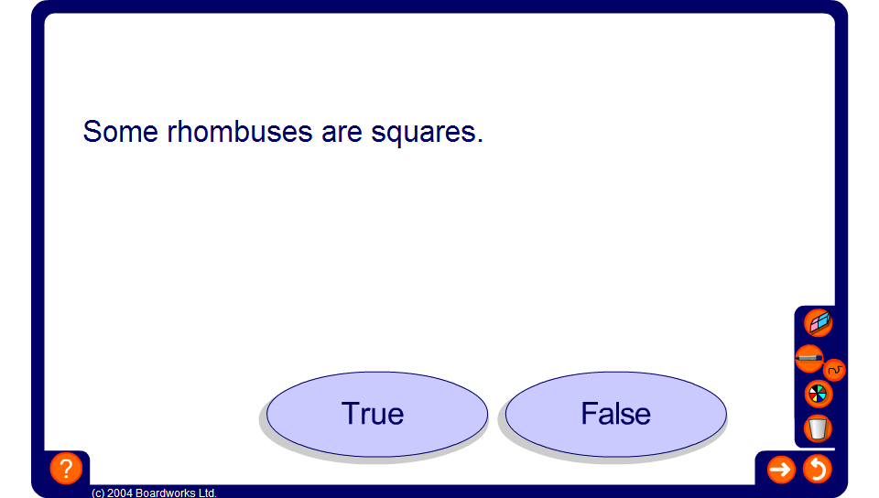


True or false
Notes:
Discuss each statement with the class and ask the pupils to say whether they think each statement is true or false.
If pupils cannot agree, ask them to give examples or counter-examples to support their argument.

